Slide 1

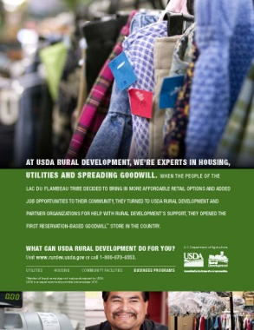





USDA Rural Development
Sustaining Relationships Throughout
Indian Country

Slide 2
USDA Rural Development
National Office
General Field
Representatives
Native American
Coordinators
State Directors
Area Directors
Program Directors
Specialists
Architects
Engineers
Technicians

Slide 3
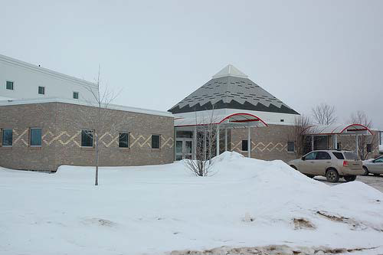
USDA Rural Development
4 Types of Program Delivery
  Grants
  Direct Loans
  Guaranteed Loans
  Payment Programs
3 Program Areas
  Rural Business and Cooperative Service
    Business, Cooperative & Energy
  Rural Housing and Community Facilities Service
    Community Facilities, Single Family Housing & Multi Family
  Rural Utilities Service
    Water and Environmental, Telecomm & Electric
Bois Forte Tribe
Community Center
Notes:
Program eligibility is nuanced.
Definitions and rules are program specific.

Slide 4
RBOG Purpose
Primary objective is promoting sustainable economic development in rural communities with exceptional needs

Slide 5
RBOG Background
Tribes, non-profits, higher education institutions, public bodies, and rural cooperatives are eligible to apply
$2.37 million total funding, with $1.14 million reserved for tribal projects
No maximum amount for tribal projects, $50,000 maximum for general projects
Application deadline is August 6th

Slide 6
RBOG Eligible Applicants
Public bodies
Non-profit corporations
Higher education institutions
Federal or state recognized Indian tribes
Rural cooperatives

Slide 7
RBOG Eligible Uses
Rural business incubators
Technology-based economic development
Feasibility studies and business plans
Long-term business and strategic planning
Leadership and entrepreneur training
***Applications that support regional economic development are encouraged***

Slide 8
RBOG Ineligible Uses
Funds cannot be used for:
  Construction
  Planning a facility
  Engineering work
  Revolving loan funds

Slide 9
RBOG Case Studies (2011)
Ione Band of Miwuk Indians - $118K
  5 County Broadband feasibility study
Tuolumne Band of Me-Wuk Indians - $197K
  Job training for Fuels and Fire Crew
First Nations Oweesta Corporation - $150K
  Financial literacy, credit coaching, and business development for 3 start up CDFIs in CA, ID & MT
Nez Perce Tribe - $47K
  Establish a business Info Research Library and Chamber of Commerce with a leadership development program

Slide 10
RBOG Case Studies (2011)
Fort Abraham Lincoln Foundation - $45K
  Train 4 Native American professional interpreters at On-A-Slant Village
Standing Rock Sioux Tribe - $150K
  General economic development services
Indian Country Age Resource Development Corporation - $72K
  Ag entrepreneur training for producers to supply meat and vegetables to SW Oklahoma food deserts
Cherokee Nation- $50K
  TA and Training for existing and prospective entrepreneurs

Slide 11
RBOG Case Studies (2011)
Coquille Indian Tribe - $58K
  Feasibility study for a tribally-owned wastewater treatment facility
Hunkpati Investments, Inc. - $50K
  Entrepreneurship course, TA & marketing assistance to businesses
Four Bands Community Fund, Inc.- $50K
  Train business owners on green business practices and work to produce 10 successful RD REAP applications coupled with fund assistance
Squaxin Island Tribe - $49K
  Establish a business incubator and mentoring program at the Tribe’s Ta-Qwo-Ma Business Center
Great Lakes Inter-Tribal Council, Inc. - $22K
  Provide technical assistance to tribal enterprises and Native American businesses, including financial and job skills training

Slide 12
RBOG Evaluation & Scoring Process
RBOG is a highly competitive grant with a points-based evaluation process
Scoring process:
    0 to 10 points: will the resulting economic development be sustainable over the long-term by local efforts without government or outside subsidies
    0 to 10 points: Agency assessment on whether the project should lead to improvements in the quality of economic activity within the community, such as higher wages, improved benefits, greater career potential, and the use of higher levels of skills than are currently typical within the economy
    Contributing component of larger economic development program:
        30 points: less than 20% of total funding will come from RBOG
        20 points: 20-50%
        10 points: 50-75% AND 0 points if 75% or more

Slide 13
RBOG Evaluation & Scoring Process
  Community characteristics (not to exceed 40 points):
      15 points: Experiencing trauma from natural disaster within last three years & project will help address continuing impacts from that trauma
      15 points: Undergoing structural change from event in last 3 years such as factory closing
      10 points: has experienced long-term poverty
      10 points: has experienced long-term population decline
      10 points: has experienced long-term job decline
  0 to 10 points: Agency determination of extent of usefulness of new best practice
  Up to 15 points: State Director’s discretion; Agency Administrator may assign up to 20 points if project is under discretion of National Office

Slide 14
Steps to Submitting Application
Applications should be submitted to local Rural Development office
Check announcement in Federal Register for list of exact required documents
Closely follow scoring criteria and announcement instructions

Slide 15
Required Documents
Applicant’s organizational documents
Proposed scope of work: description of project, details of the proposed activities and timeframes for completion, number of months of project, estimated time from grant approval to beginning of implementation
Written narrative:
  Explanation of why the project is needed, the benefits of the project and how the project meets the grant criteria
  Area to be served, including each government unit to be affected by project

Slide 16
Required Documents
Written narrative cont.
  Business to be assisted, if appropriate; economic development to be accomplished
  Explanation of how the project will result in increased or saved jobs in the area and the number of saved jobs
  Description of the applicant’s demonstrated capacity and experience in providing the proposed assistance or similar economic development activities, including experience of key staff members
  Method and rationale used to select the areas and businesses that will receive service

Slide 17
Required Documents
Written narrative cont.
  Brief description of how the work will be performed including whether organizational staff or consultants will be used
Latest organization financial information showing capacity to carry out work
Evaluation method to determine if the proposed objectives are being accomplished

Slide 18
Building Relationships
Importance of building relationships between you and local RD Staff
Importance of building relationships between applicants and local RD Staff
RD AI/AN Coordinators
  www.rurdev.usda.gov/AI_ANCoordinators.html
State Office Pages
  www.rurdev.usda.gov/recd_map.html

Slide 19
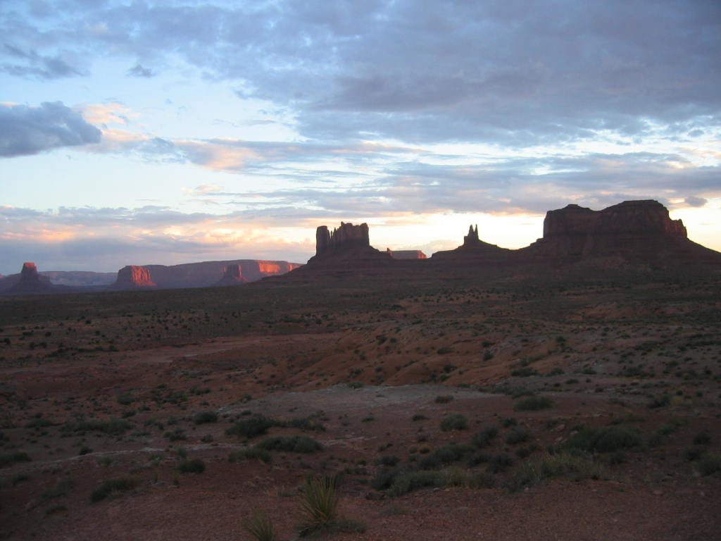
Contact information
Tedd Buelow
Native American Coordinator
USDA Rural Development
(720) 544-2911
Tedd.Buelow@wdc.usda.gov
www.rurdev.usda.gov/AI_ANHome.html

